Slide 1

Summary
What is a summary?

Slide 2
- A summary is a shortened version of an original text or passage.
According to Langan, a summary is “the reduction of a large amount of information to its most important points.”
It aims to share the main idea by eliminating irrelevant details.
The tone of the original piece must be maintained by avoiding opinions.
It retains the essential information of the original.

Slide 3
- It is a brief restatement– in your own words of the contents of the source text.
- You simply report back what the writer has said without making value judgments.
Filter out the information from your general passage.
Eliminate all examples and supporting ideas.

Slide 4
6 STEPS FOR WRITING A SUMMARY
Find the main idea
Find the supporting details
Write summary sentences
Combine main idea with summary sentences
Re-read and edit
Check final draft

Slide 5
Find the main idea
Read the passage the first time for understanding.
Ask yourself, “ What was the passage about?”
Hint: if you are having problems, scan the passage to seen which ‘Topic’ word appears most often .This is likely the topic of the passage.
Know you have to figure out what is being said about the topic.

Slide 6
Find the main idea
Read the passage a second time.
What is the overall point being made about the topic word?
You need to be able to see the ‘big picture’ being presented by the passage.
This is the main idea of the whole passage; write it down.

Slide 7
Find the main idea
Avoid irrelevant information. These are usually the elaborating details which support the main idea. MORE FEDS is one way to help you to identify what these are.
MORE FEDS
Minor details 5. Figure of speech
Opinions 6. Evaluations
Repetitions 7. Dialogue/Quatations
Examples 8. Statistical data

Slide 8
2. Find the supporting details
Supporting ideas are used to develop, explain or expand on the main idea.
While “skimming” (quickly reading through) the passage for the third time, look for the supporting ideas by reading over the opening sentences of the paragraphs.

Slide 9
3. Write summary sentences
After reading the passage for the third time, write one or two summary sentences for each paragraph describing the main idea that you see expressed by the paragraph.
If you see yourself repeating the same ideas, you will need to read the passage again to get a clearer picture and then revise your summary sentences.

Slide 10
4. Combine the main idea with summary sentences
Join together the main idea of the passage and your paragraph summary sentences by using transitional words and/ or phrases.
These transitional words/ phrases do three things:
They give your summary a sense of being a “whole”- not just a group of unconnected sentences.
They also make your summary “flow” smoothly when reading.
They reinforce and support the main idea being expressed in the passage.

Slide 11
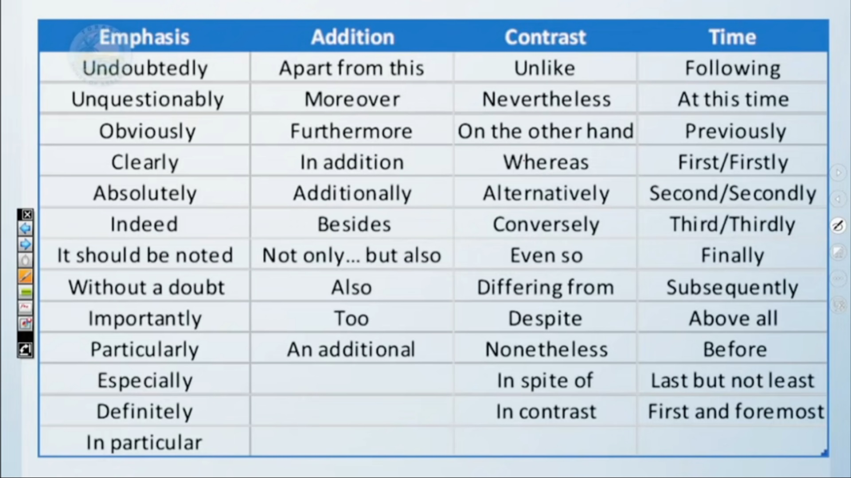

Slide 12
5. Re-read and edit
Reread( and edit if necessary) the summary to make sure it clear and to the point.
Eliminate the repetitive words, too many descriptive words and non-essential words.
Pay attention to the word limit.
The final version should read like a whole, sensible piece of writing.
Remember to check your grammar and spelling.

Slide 13
6. Check the final draft
Finally, check your summary against the author’s original. Have you correctly described the author’s main idea and the essential supporting points?
Make any necessary adjustments or changes to your summary.

Slide 14
Paraphrasing
Paraphrasing = restating in your own words what another person has said or written.
In other words, paraphrasing is the ability to write your own version of the essential information without changing the meaning and the facts of the original text.
You can paraphrase by changing the word forms or using synonyms and changing clause or phrase structure.

Slide 15
Characteristics of a good summary
Can be understood without reference to the original.
It is a faithful reproduction of or contains only the ideas or information of the original.
Is brief without any unnecessary detail.
Is a readable unified whole.

Slide 16
Thank you for listening

